Slide 1
The Outliers We’re Forced to Accept
Charlie Yaris
Notes:
I’ll be predicting the price that customers pay for prescription drugs per pill. I’ve called this the outliers we’re forced to accept because there are some really big outliers in the distribution of drug prices and patients who rely on them are often forced to purchase them regardless of price.

Slide 2
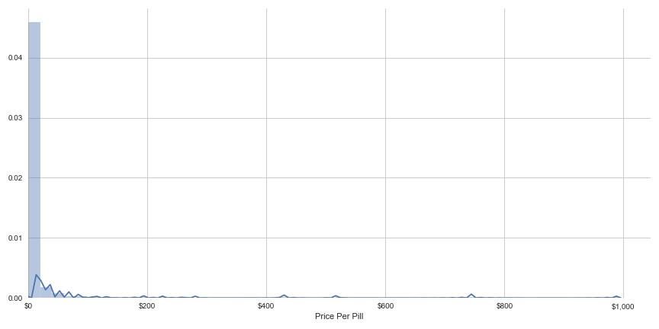
Distribution of Prices for Individual Pills
x̅ = 15.43
σ = 77.25
Notes:
Why bother?

Slide 3
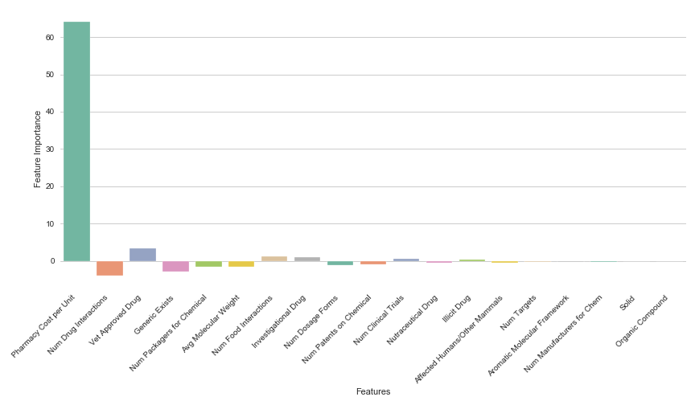
Feature Importance for Prescription Drug Prices

Slide 4
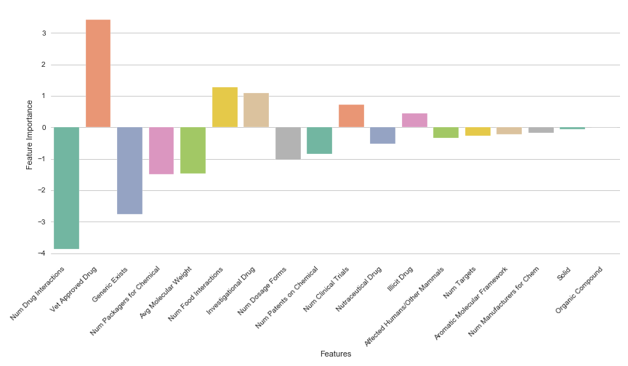
Feature Importance for Prescription Drug Prices

Slide 5



Data Sources

Slide 6
Modeling Process
Initial dataset began with 2,294 drugs.
Modeled on 1,031 drugs in pill form.
X – 19 features (9 dummy variables).
y – Lowest possible price per pill for each drug.
Simple linear regression yielded lowest RMSE in all tests.
Notes:
Removed Null Values
Checked for price > cost
Kept only drugs in pill form.
I only looked at pill because my Medicaid data was based on cost per unit which was easy to calculate for pills, but difficult to figure out how many units to assign to other drugs like ear drops and eye drops.

Slide 7
Scores and Metrics
• Simple Linear Regression
with All 19 Features
• Simple Linear Regression
with Only Pharmacy Cost
• Simple Linear Regression
without Pharmacy Cost
Train R ² | 0.64
Test R ² | 0.82
Test RMSE | 29.63
Train R ² | 0.63
Test R ² | 0.83
Test RMSE | 28.32
Train R ² | 0.07
Test R ² | -0.03
Test RMSE | 68.52
Notes:
Last one looks bad, but the RMSE is still less than the standard deviation.

Slide 8
Takeaways
Possible error within our features/model.
Profit margin for pharmacies is relatively consistent for all drugs.
Insights into positive and negative correlations.
Number of Drug Interactions: Negative -3.87 Feature Weight
Vet Approved Drug: Positive 3.43 Feature Weight

